Slide 1

MANAGEMENT OF NATURAL RESOURCES
Reduce, Recycle, Reuse

Slide 2


Students you must have come across the three R’s to save the environment: Reduce,
Recycle and Reuse.
Let us understand, What do they refer to?

Slide 3


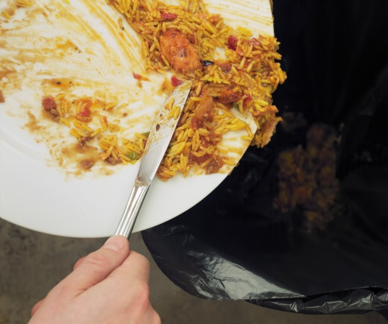
Reduce
Recycle
Reuse
Use less resources
Save electricity by switching off unnecessary lights and fans
Save water by repairing leaky taps
Do not waste food

Slide 4
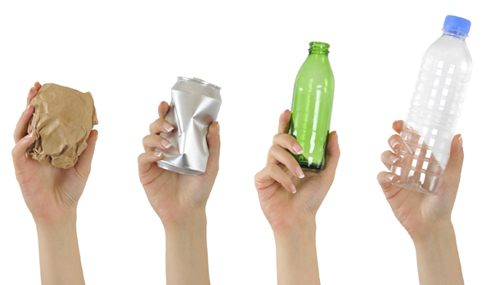
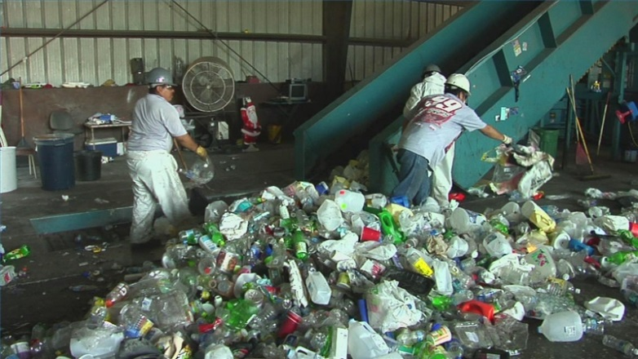
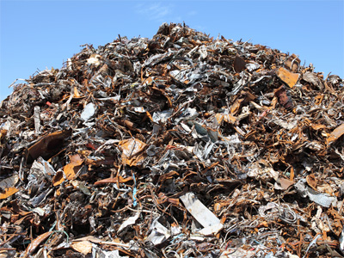
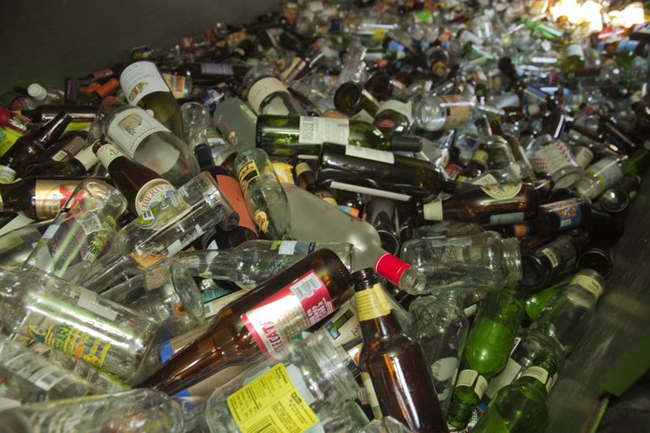
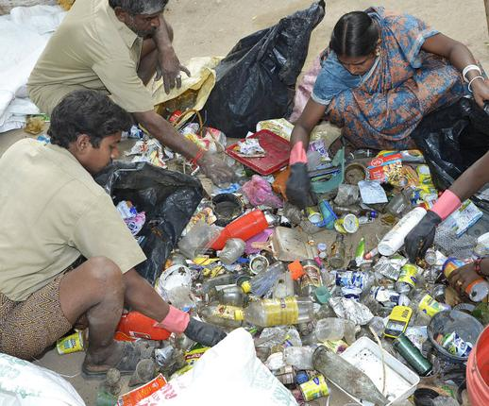
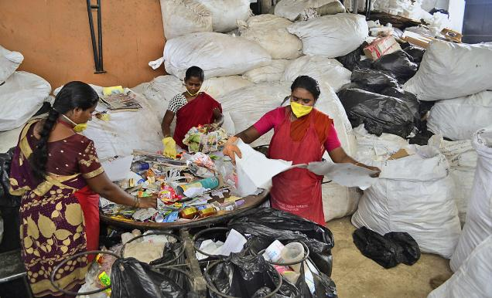

Reduce
Recycle
Reuse
Collect paper, plastic, glass and metal items
Recycle them to make required things instead of synthesizing or extracting fresh ones.
We first need to segregate our wastes

Slide 5
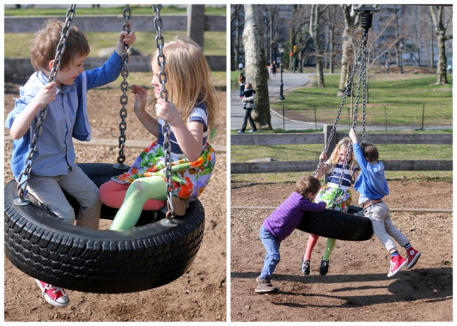
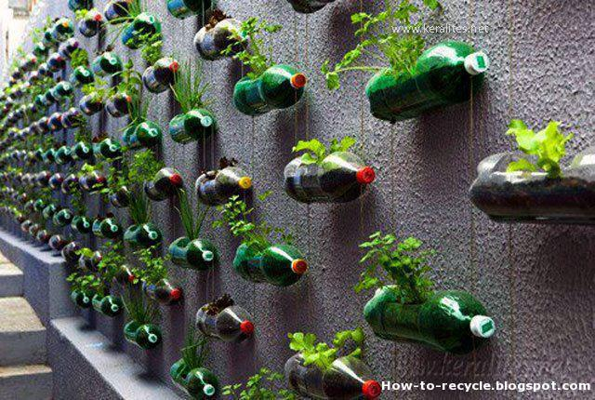

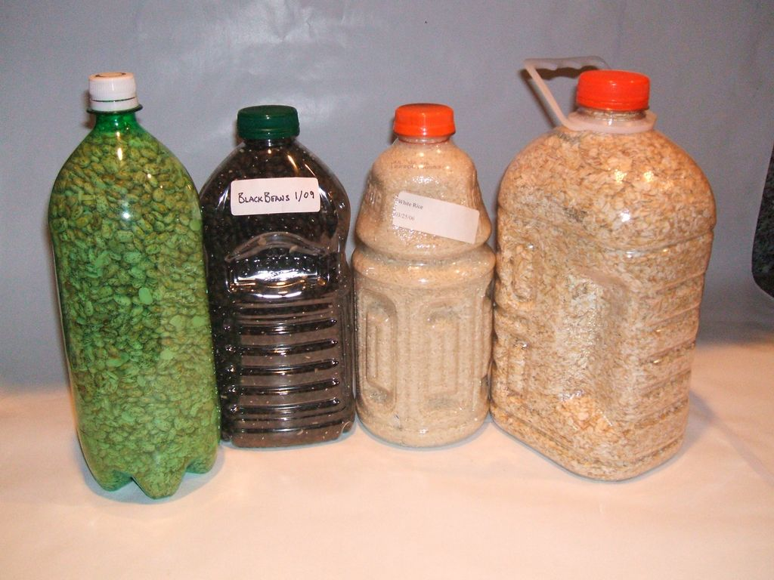
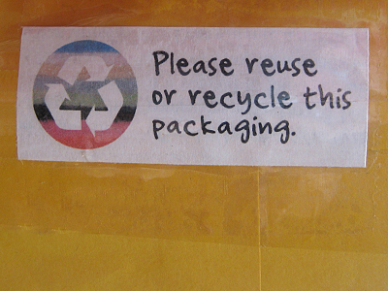
Reduce
Recycle
Reuse
Simply use things again and again
Instead of throwing away used envelops you can reverse it and use it again.
Plastic bottles can be used for storing things in the kitchen.

Slide 6

But students even while making everyday choices, we can make environment friendly decisions.

Slide 7

For doing this, we need to know more about how our choices affect the environment, these effects may be immediate or long term or long-ranging.

Slide 8
Thank You

